Slide 1


Python Exercise
String data type

Slide 2
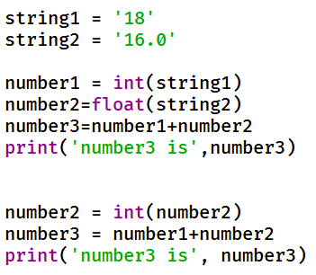
Question 1
What are the correct results of the following code after execution?
A. number3 is 34
B. number3 is 34.0
C. number3 is 18
D. number3 is 18.0
E. number3 is 16
F. number3 is 16.0

Slide 3
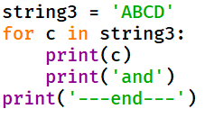
Question 2
What is the correct result of the following code after execution?
A
B
C
D
---end---
ABCD
and
---end---
A
and
B
and
C
and
D
and
---end---
A
and
---end---
B
and
---end---
C
and
---end---
D
and
---end---

Slide 4
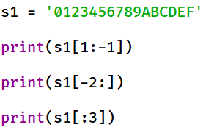
Question 3
What is the correct result of the following code after execution?
0123456789ABCDEF
DEF
012
123456789ABCD
EF
01
123456789ABCDE
EF
012
123456789ABCDE
DEF
01

Slide 5
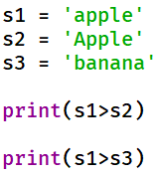
Question 4
What is the correct result of the following code after execution?
True
False
False
True
True
True
False
False

Slide 6
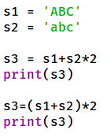
Question 5
What is the correct result of the following code after execution?
ABCabcABCabc
ABCABCabcabc
ABCabcabc
ABCabcABCabc
ABCABCabcabc
ABCabc
ABCabc
ABCabcABC

Slide 7
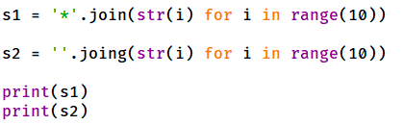
Question 6
What is the correct result of the following code after execution?
0*1*2*3*4*5*6*7*8*9
0123456789
*0123456789
0123456789
*010
010
*0*1*2*3*4*5*6*7*8*9
0123456789

Slide 8
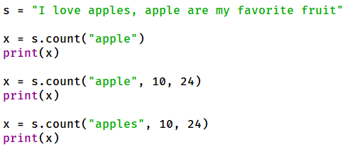
Question 7
What is the correct result of the following code after execution?
2
1
0
2
2
1
1
1
0
2
1
1

Slide 9
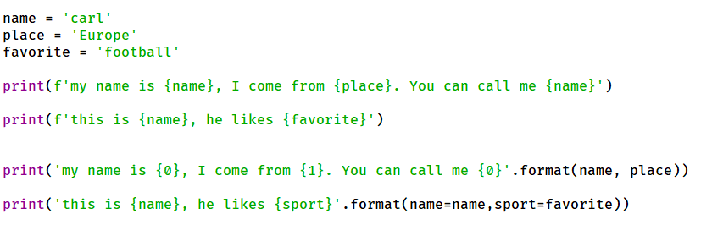
Question
What is the correct result of the following code after execution?

